Slide 1
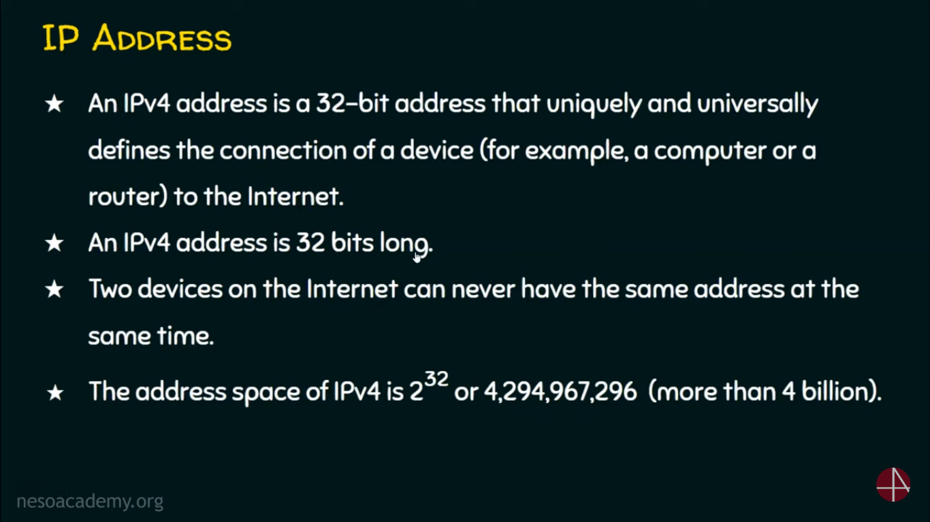

Slide 2
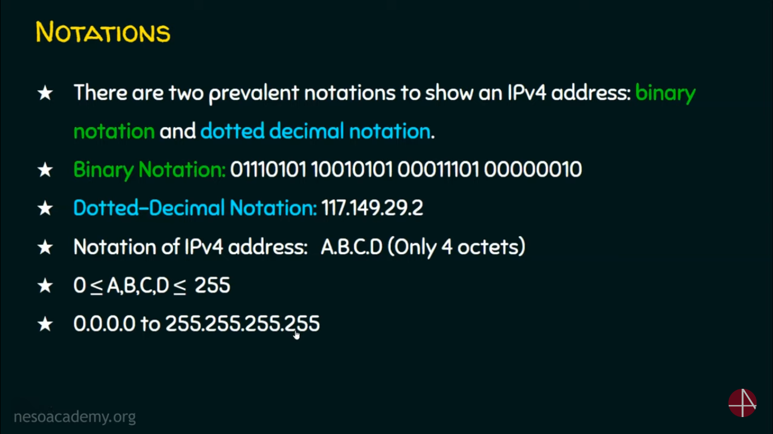

Slide 3
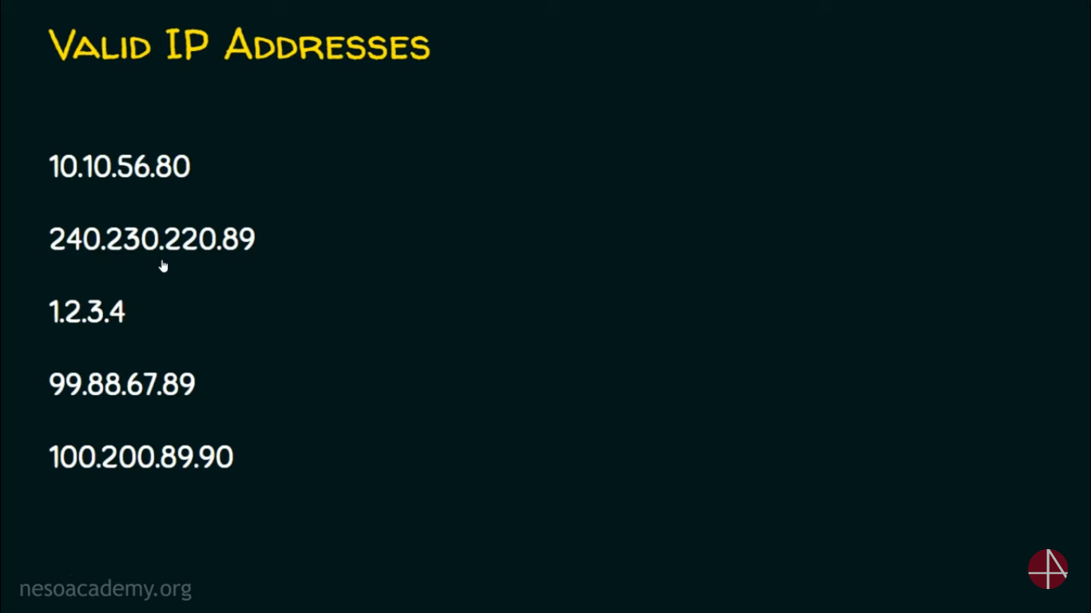

Slide 4
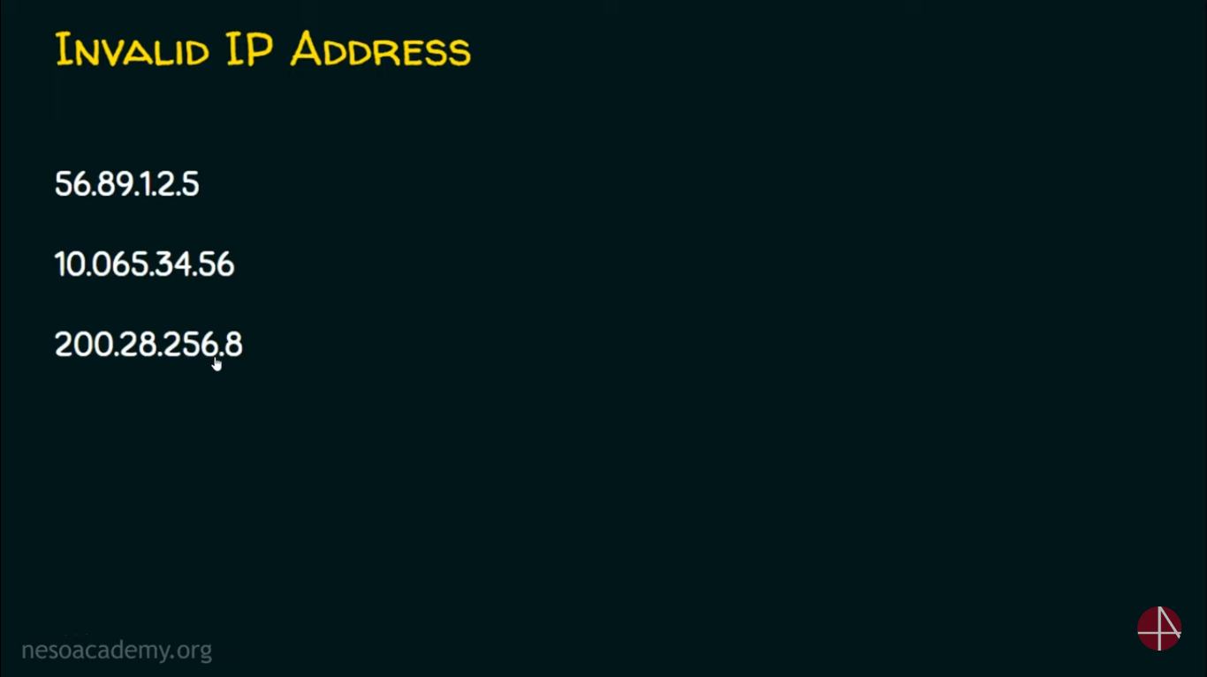

Slide 5
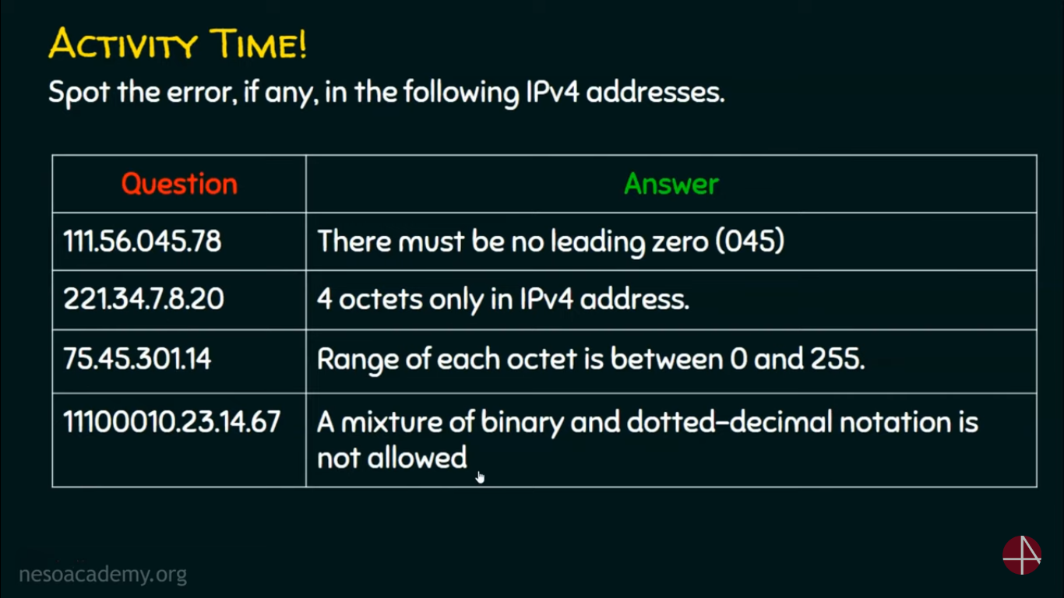

Slide 6
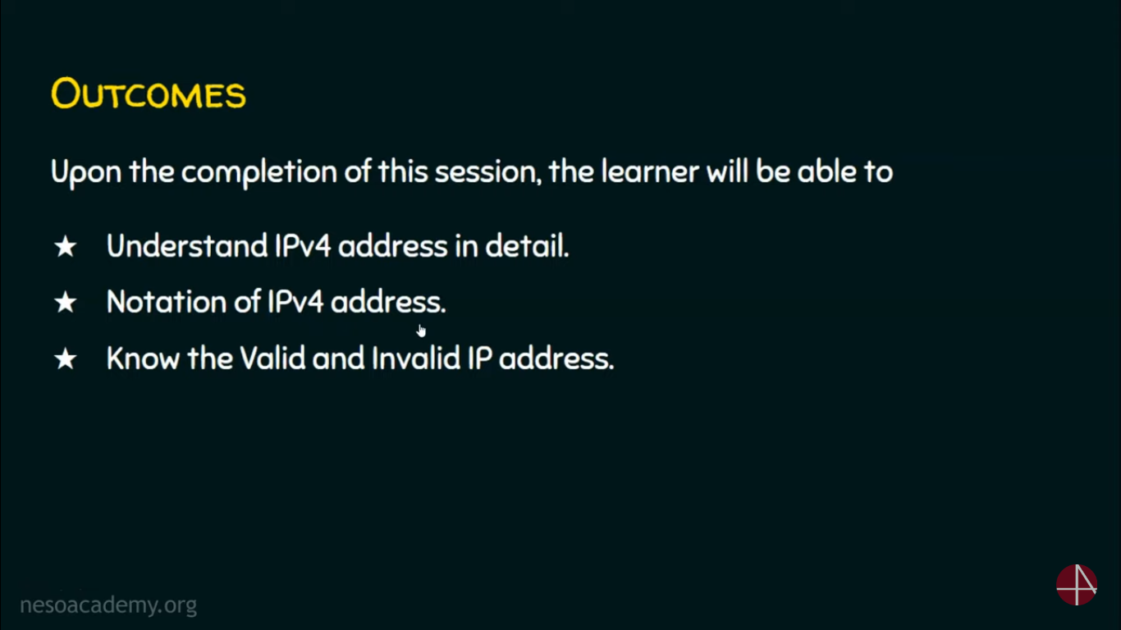

Slide 7
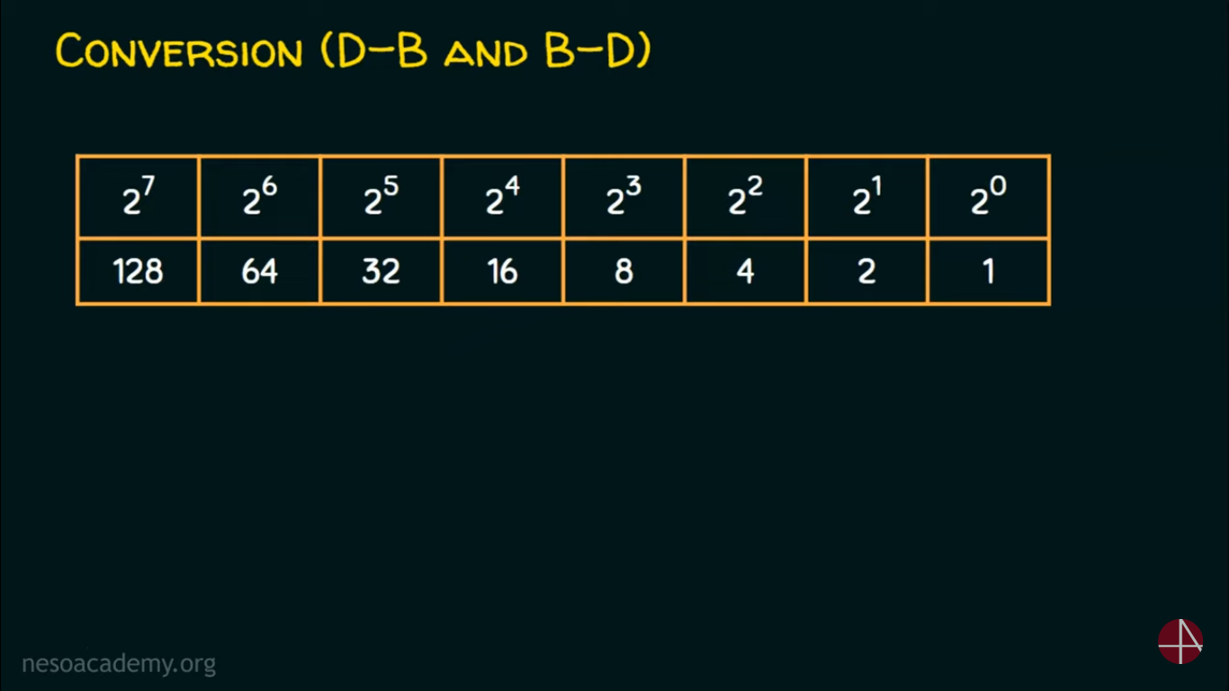
Notes:
now let's have a look at Kinesis data stream in detail
Understand Kinesis Data Stream(KDS)
all right so when you create a Kinesis data stream you have to Define how many
shards does that stream consist of now there are two modes that currency data
stream supports on demand mode and provision mode so if you are using on demand mode you
don't have to necessarily Define how many shards that your stream needs
but if you're using the provision mode you have to define the number of shards so what's so important about these
shards now charts is essentially determines the throughput that this stream can supports
now each shot can support 1000 records per second data ingestion or one
megabyte of data per second whichever comes first and in the other side the consumers can
read one of the shards maximum up to two megabyte per second or 5 reads per
second so the recommendation here is if you know exactly how much throughput
requirement would you need with your data stream then you can use the provision mode or else you probably be using the
on-demand mode but keep in mind there are different consideration for the on-demand mode which we are going to look at it little
later but right now I want you to know that a stream consist data stream is consist of
shards so when you have a Kinesis data stream then you can start producing data
through the Stream so here either you can have Kinesis producer applications running in ec2
machines or you can directly push data to the currency data stream using AWS sdks
and also you can set up Kinesis agents in your service it could be even on-prem
service that will push data to the kinesi Stream so once the data is ingested the shards
will retain that data by default up to 24 hours you can extend up to 7 Days
even up to one year but you have to pay for additional retention time
and then on the other side you can Define your consumers so you can write your consumer
application and this application can also be run in ec2 instances and when you process this data in the
Stream then you can send them into other targets like Amazon S3 you can persist that in
dynamodb so on and so forth now in addition to this you can Define
your serverless consumers as well now here you can use AWS Lambda
now this is a powerful integration we are going to learn a lot about AWS Lambda and Kinesis how they work
together now before diving into shards and producers consumers and AWS Lambda
let me give you a quick demo about how does Kinesis service looks like in AWS console

Slide 8
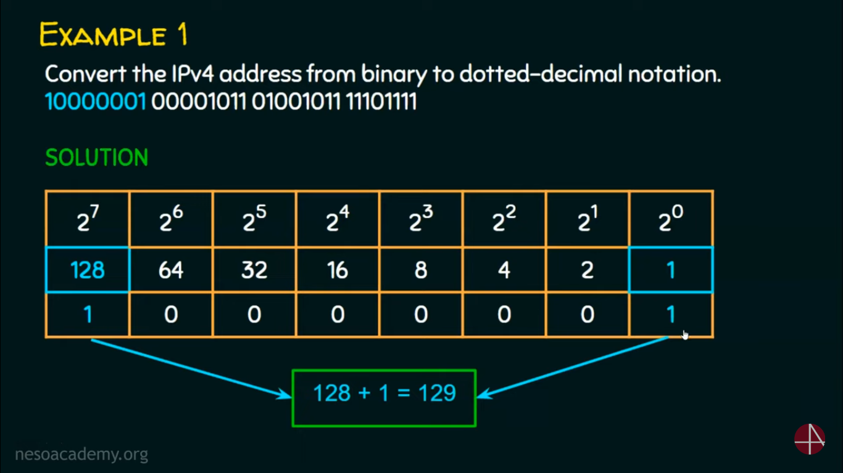

Slide 9
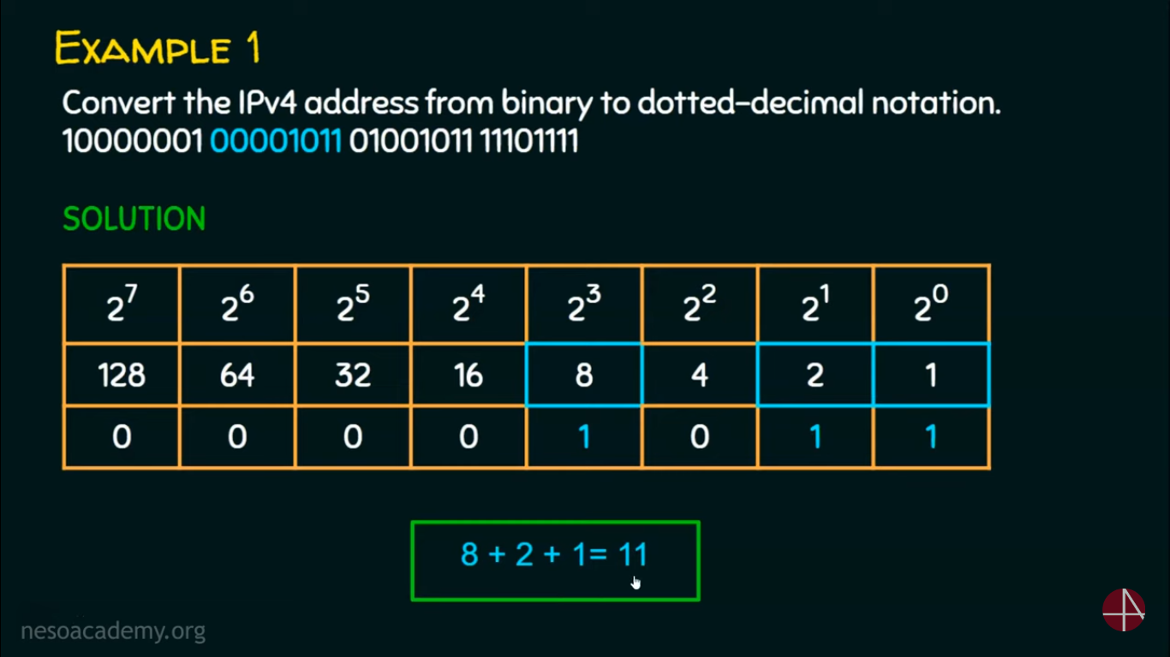

Slide 10
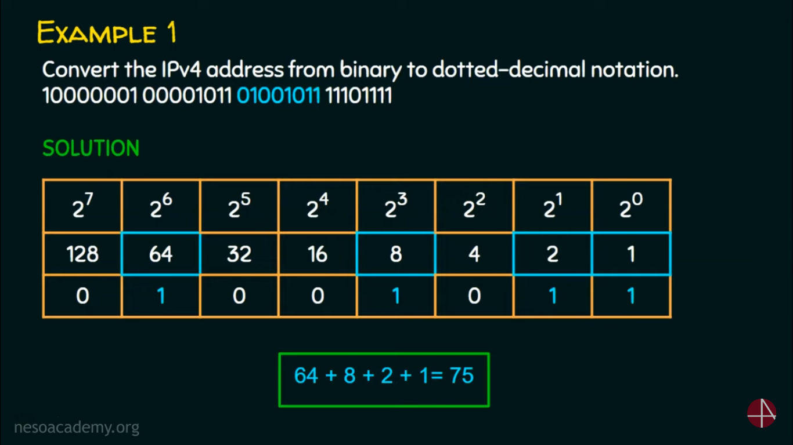

Slide 11
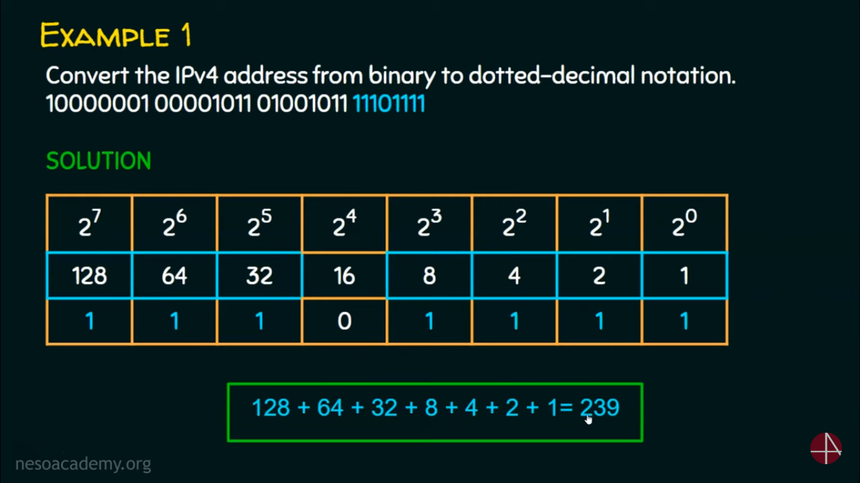

Slide 12
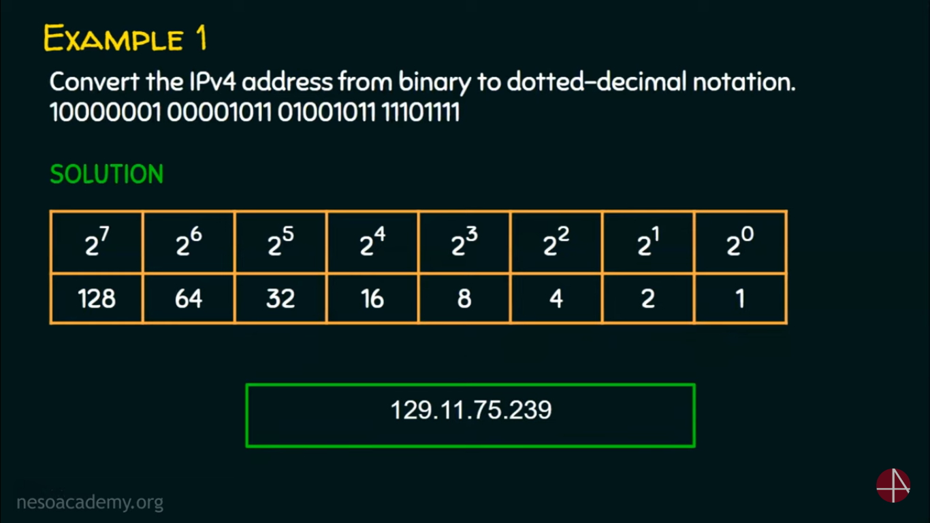

Slide 13
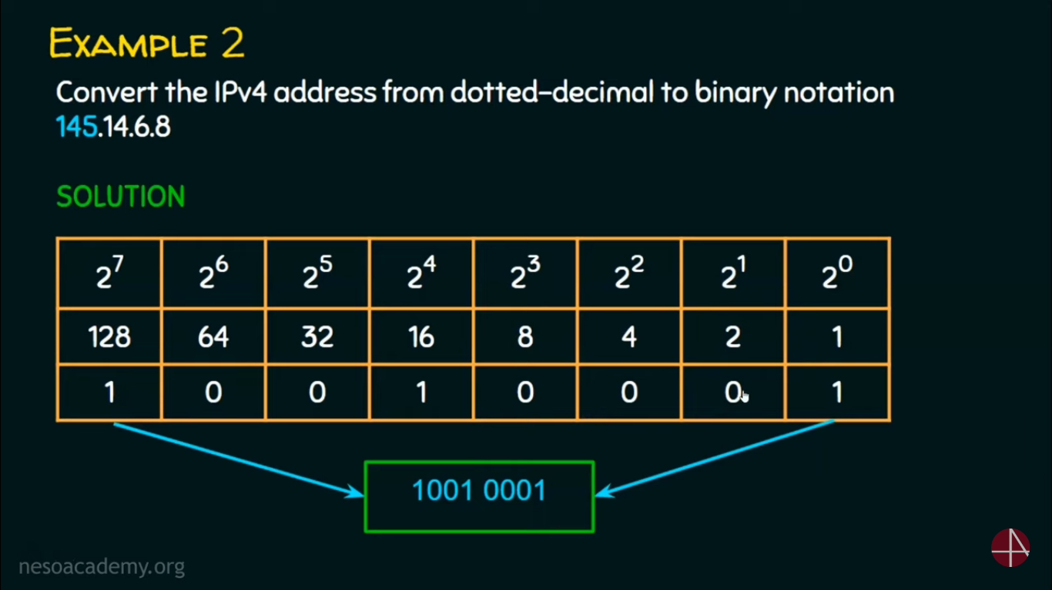

Slide 14
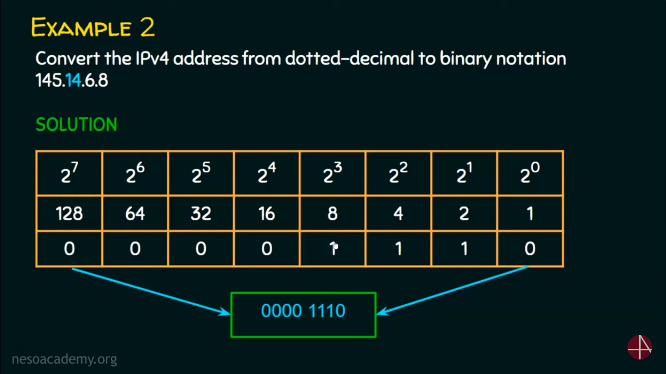

Slide 15


Slide 16


Slide 17
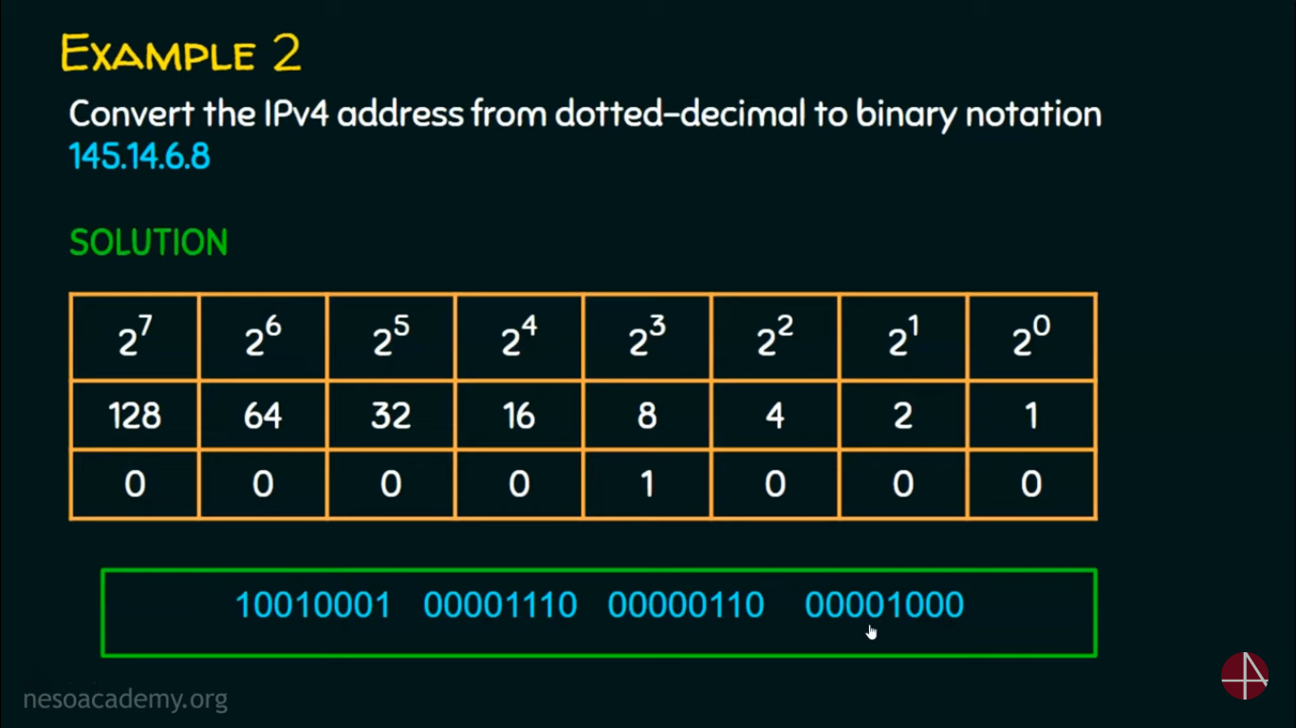

Slide 18
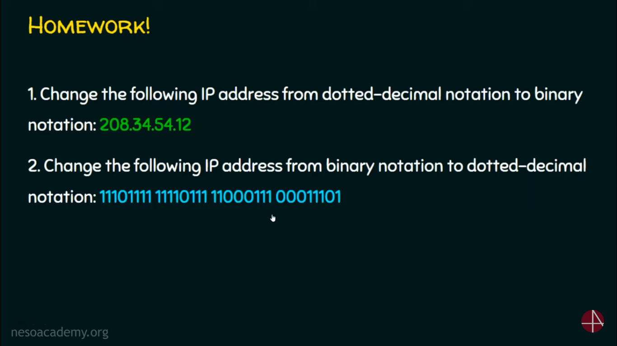

Slide 19
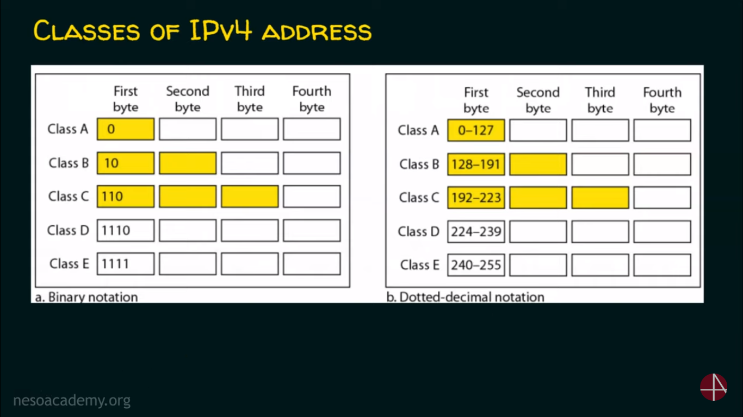
Notes:
it it will open the IM console and the role section for this IM
role is open and here under the permissions so this is the current permission that Lambda
automatically has added upon creation so it's only allowing it to log data to
Cloud watch it doesn't have anything related to thinances so what we can do here
is to add some additional permission so I can click add permission to this role
attach policies permission policy let's search for kinesis
now here we have a bunch of managed IM policies now these are managed by AWS you can create your own policy as well
but for now I will give MSN currencies read only access
so I'll attach this policy to this particular role so then this role will have that permission if you scroll down
you can see here now this role is attached to the Lambda functions meaning that our Lambda function also has the
read only permission for any Guinness stream in this account you can
be as granular as if you want with IM permissions but this is just a small demo so I'll go

Slide 20
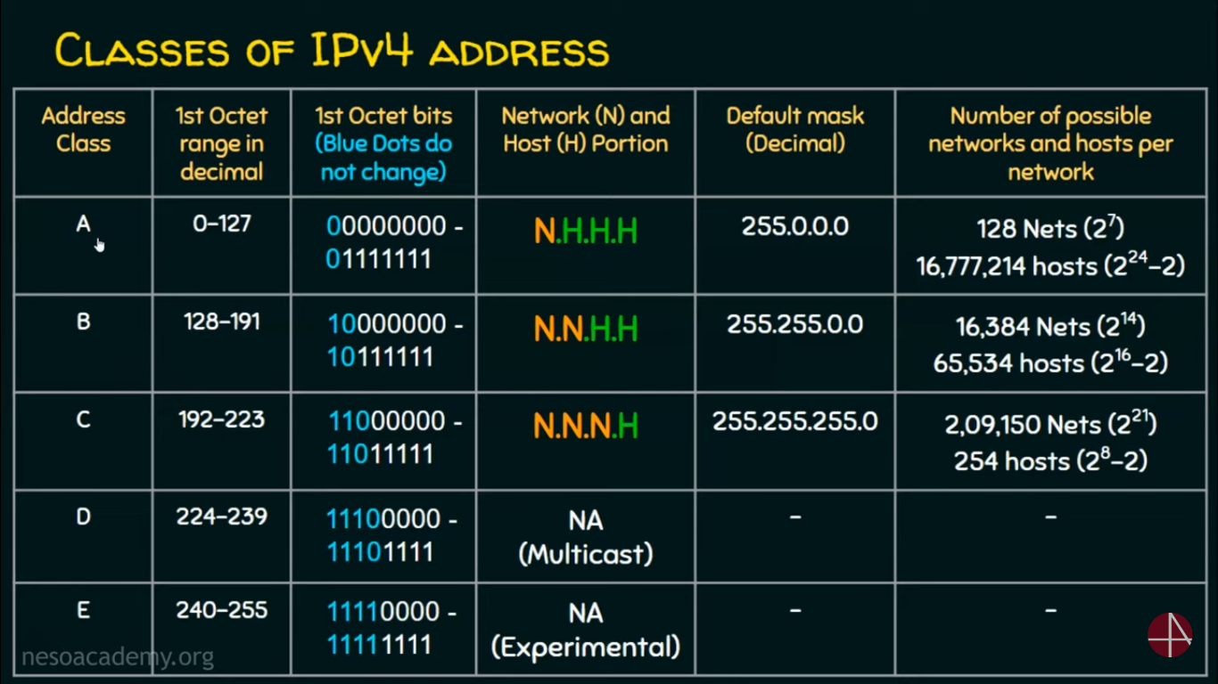

Slide 21
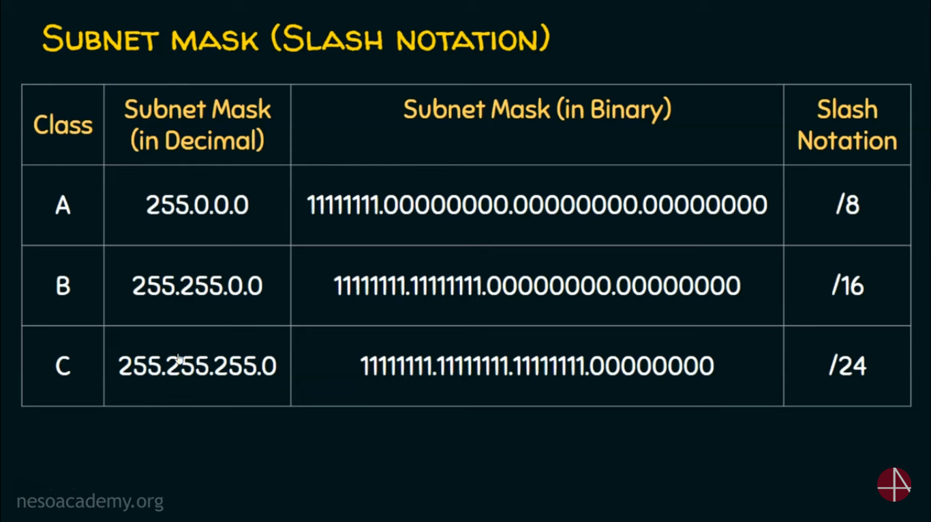

Slide 22
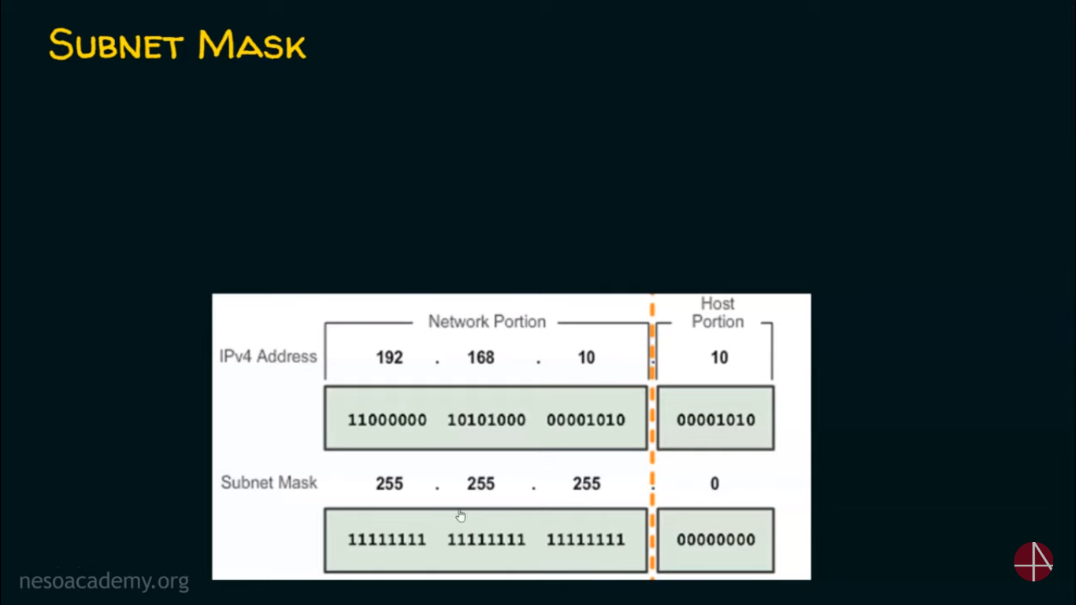

Slide 23
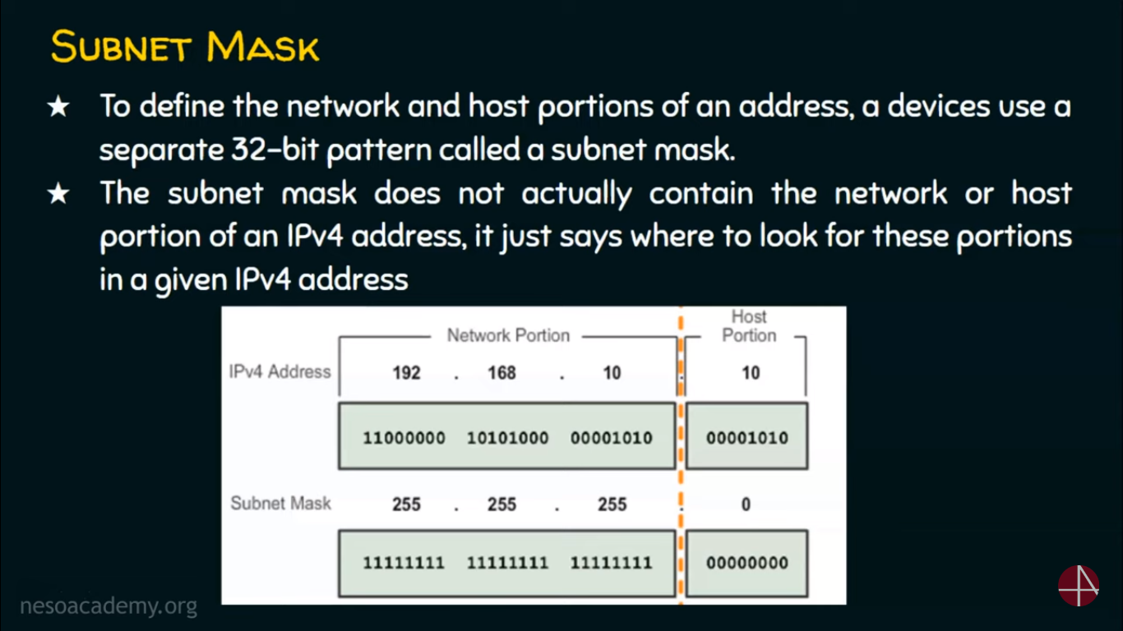

Slide 24
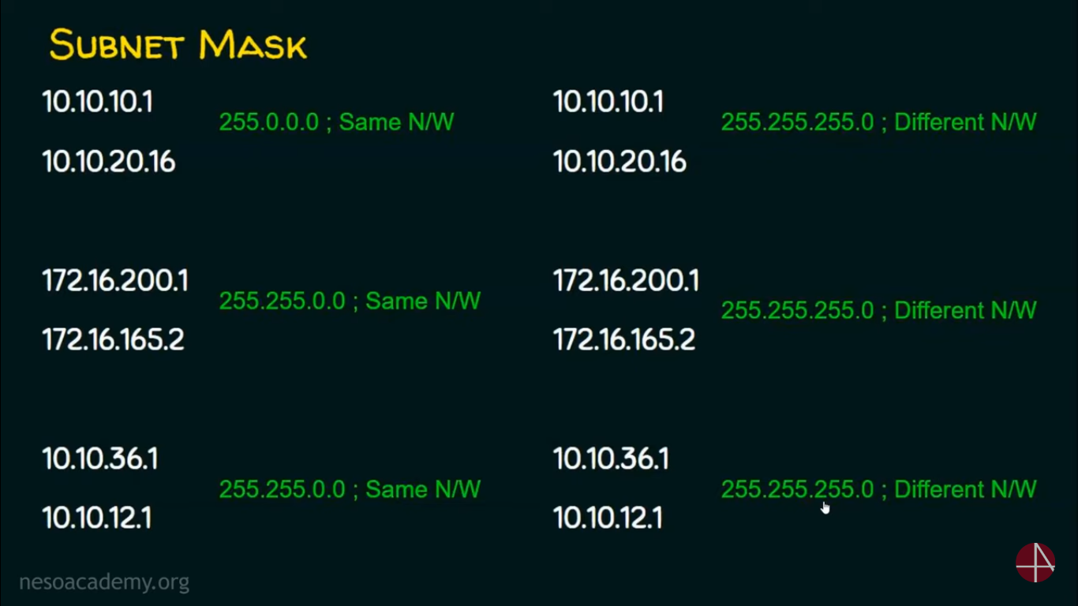

Slide 25
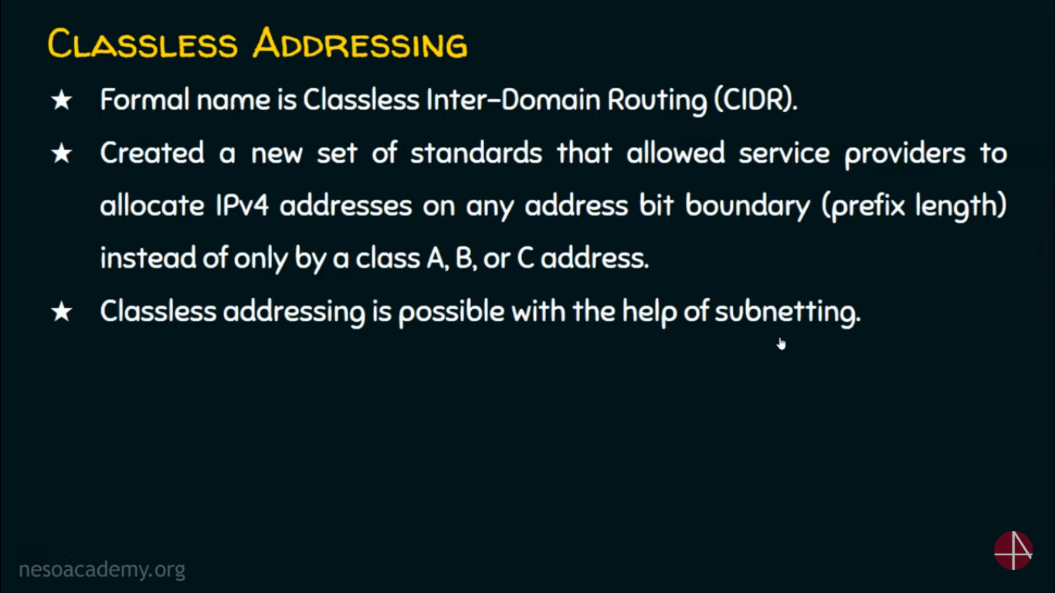
Notes:
when you have a Shard you can ingest
data records into that shards here you can use AWS SDK or produce
application to ingest records into the stream so here we have record one two
three four five six seven eight so on and so forth now here are few characteristics of these records now
these records that you ingest into a Shard are append only meaning that once you have the record in
the Stream in the chart you can't delete it unless of course the retention period is expired and the keynesis itself

Slide 26
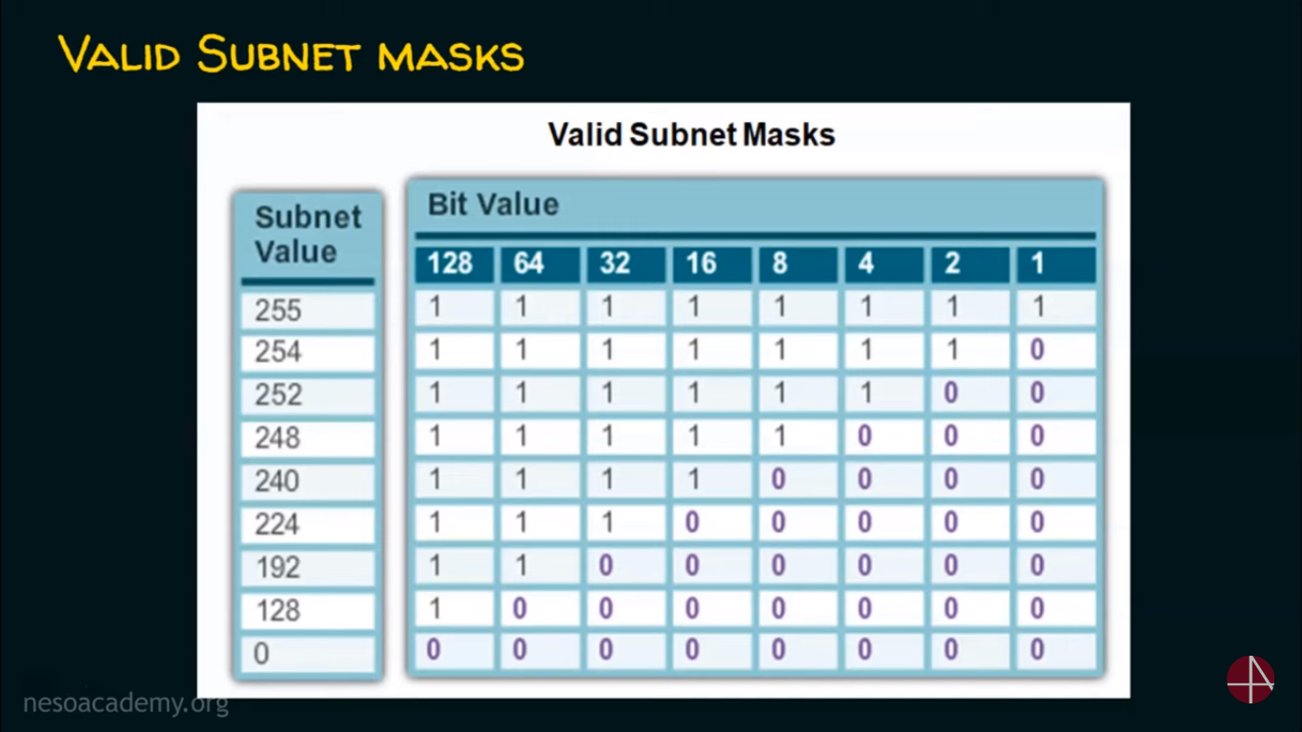

Slide 27
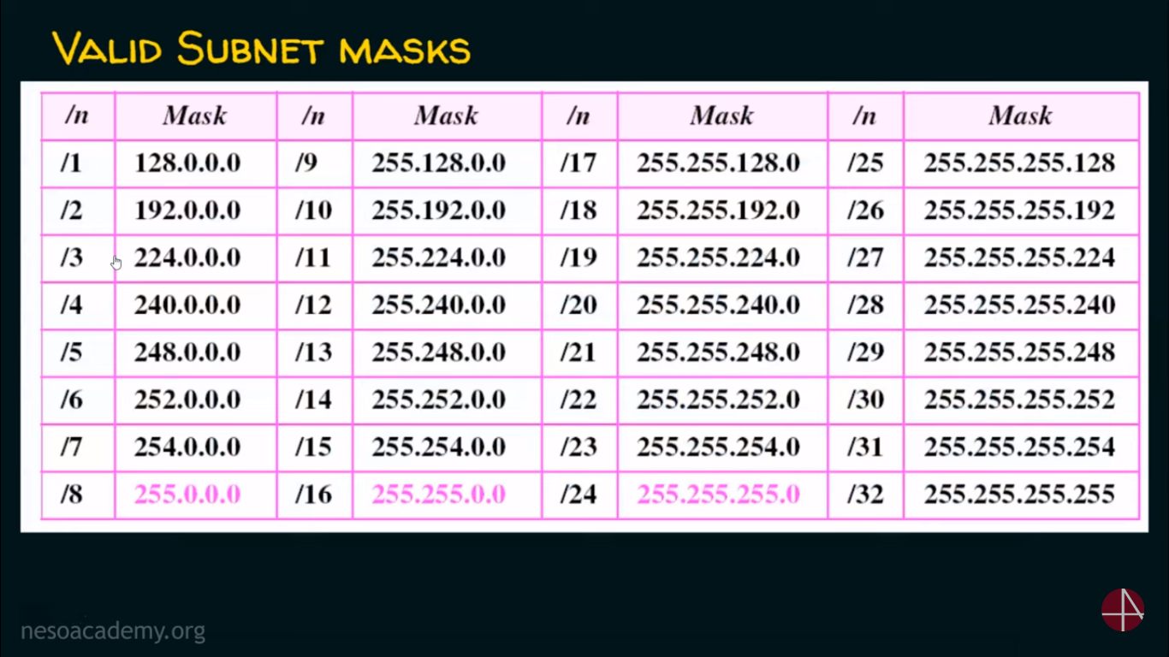

Slide 28
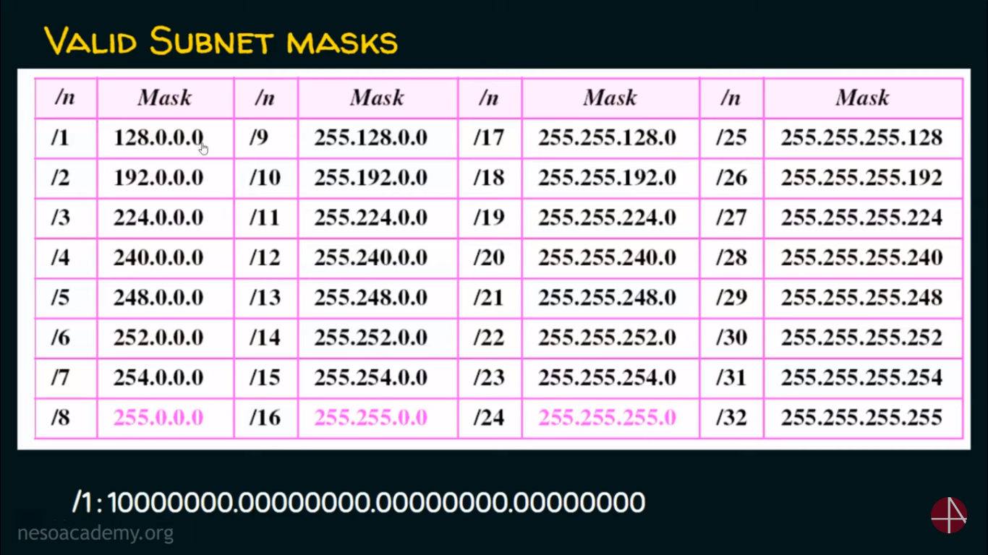

Slide 29
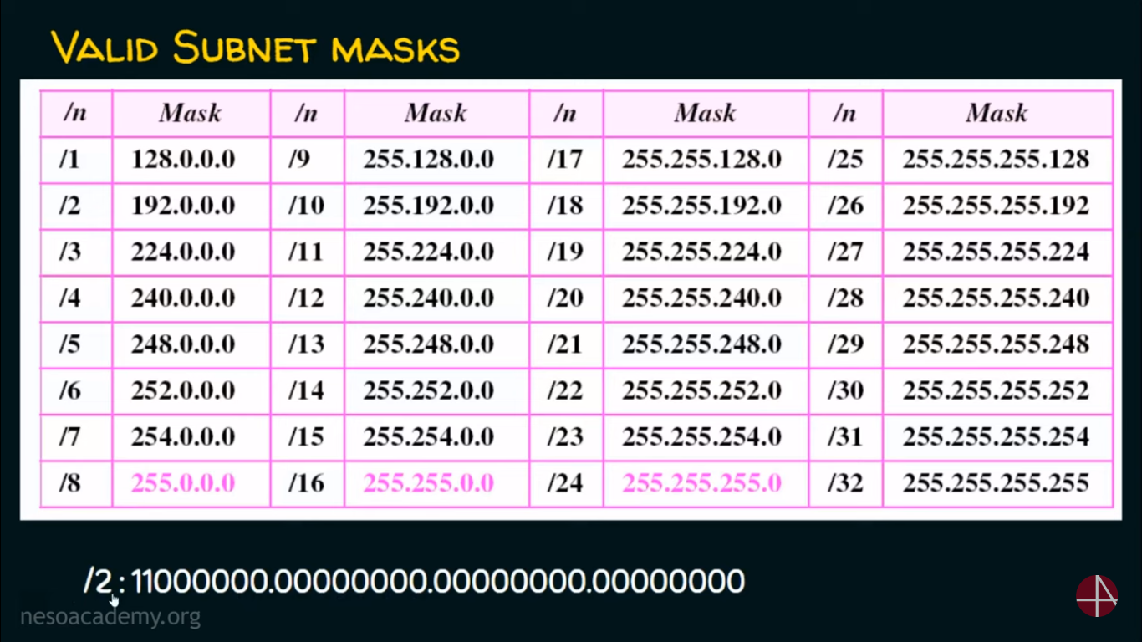

Slide 30
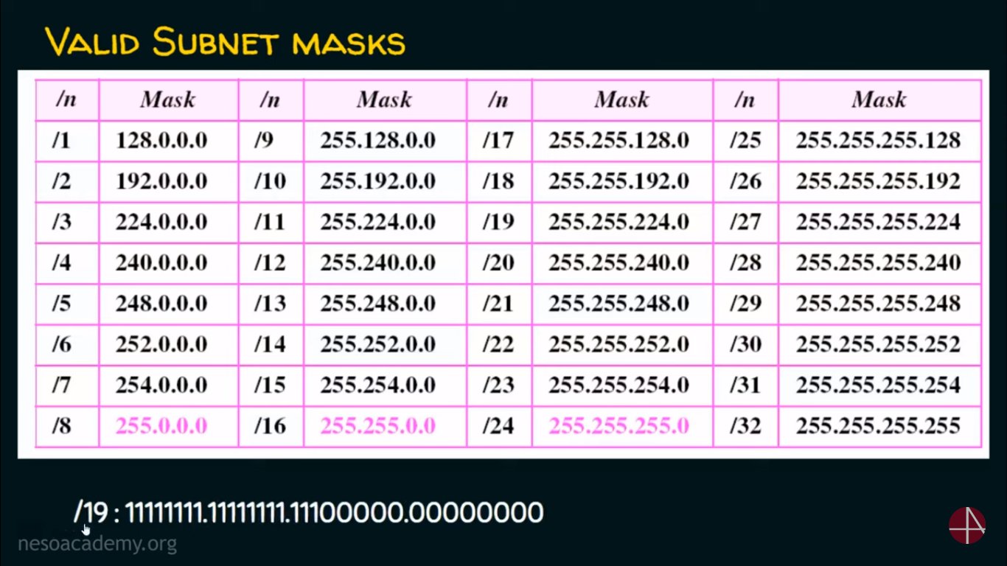

Slide 31
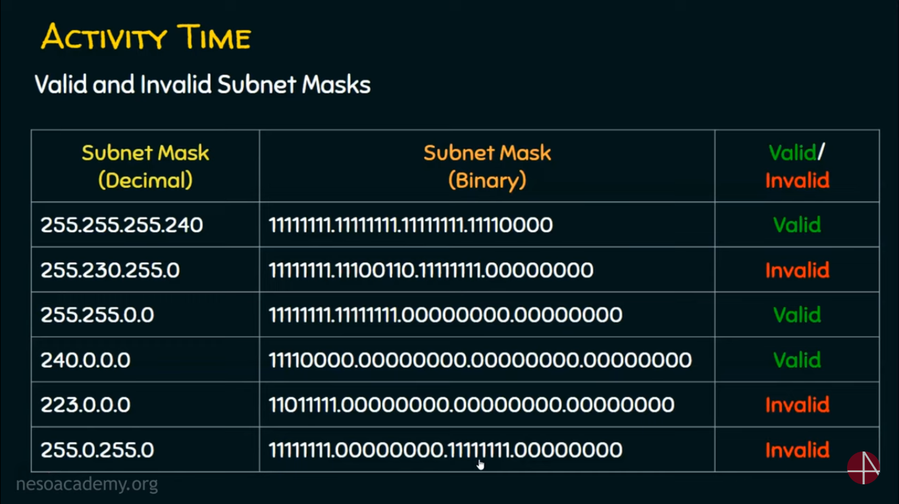

Slide 32
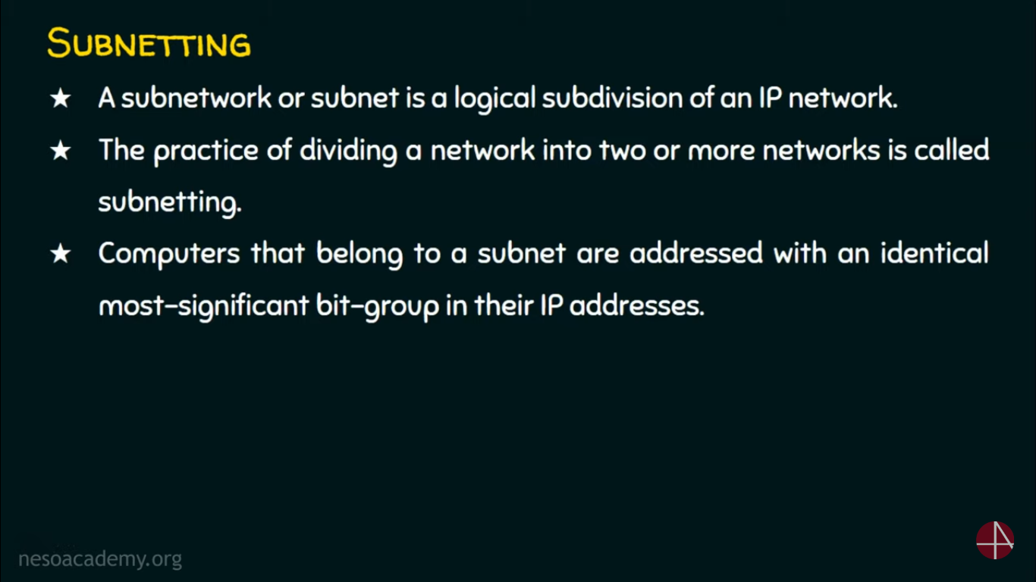

Slide 33
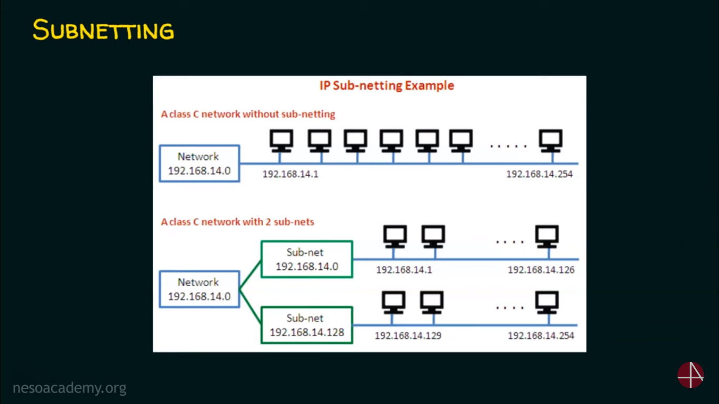

Slide 34
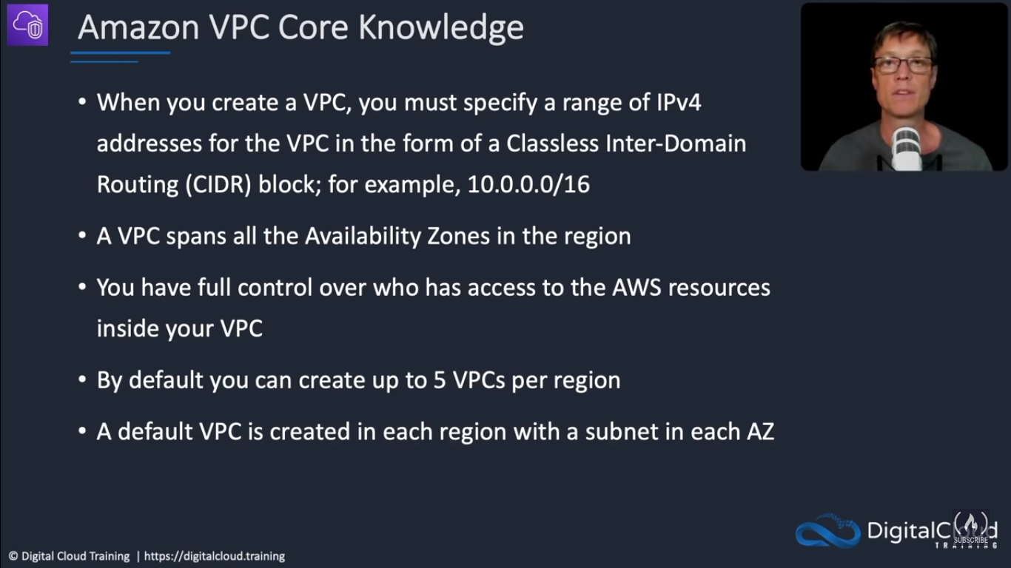

Slide 35
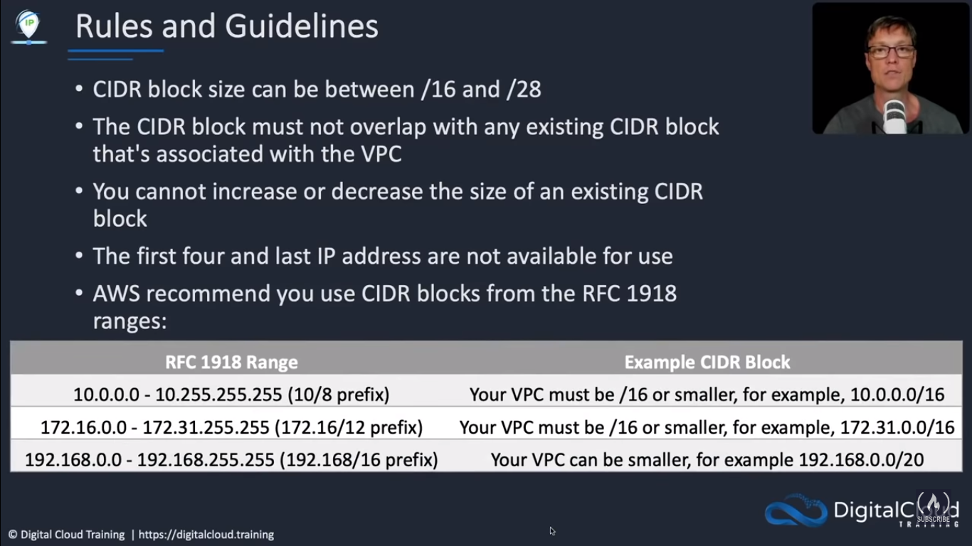

Slide 36
